Slide 1

The Art of Multi-Channel
Engagement for World in Conflict
December 16th, 2010
www.wicmwmod.com

Slide 2
Currently: Single Target, Multiple Attacks
In WIC, target acquisition and engagement is performed on a simple single target, single threaded manner.
1 target is attacked by several units that are in range to fire their weapon.
For example, if 4 heavy choppers enter into an area guarded by 4 Heavy Anti-Air units, you’ll see all anti-air units opening fire on a single chopper in most cases.

Slide 3
Pros and Cons with
Single Target Engagement
Pros/Benefits:
  Very cheap on CPU/system resources.
  Very simple, can’t go wrong.
Cons/Downfall:
  Extremely vulnerable to countermeasures and saturation attacks.
  All units target one single enemy unit, making them waste their ammo.
  Need to have very high fire-rate and unlimited ammo (like Heavy Anti-Air unit in vanilla WiC) to make up for its inefficiency and vulnerabilities.

Slide 4
MW Mod 2.0 Integrated Air Defense System (IADS)
Introduces multi-channel engagement capability to WiC.
Able to target and engage several incoming bandits on a single operating thread.
Substantially more efficient at dealing with saturation attacks.
Unlike vanilla WiC, you have to deal with cruise missiles, not just helicopter threats. This means the existing single-target engagement method is completely combat-ineffective to defend your team.

Slide 5
What is Multi-Channel Engagement?
Game engine acquires a single target and sends WIC event to our unit, instructing it to open fire.
Instead of opening fire, we don’t open fire. (huh?)
We send a “rebuttal” back to the game engine, requesting it to send us list of all enemy targets in the nearby area of where it initially acquired a target.
Game replies back to us with list of all enemy units in the area.
We build an array list of up to 9 targets (for Patriot; 12 targets for S-300) and determine their flight heading and speed.
Each target in the list is called “Engagement Channel”.

Slide 6
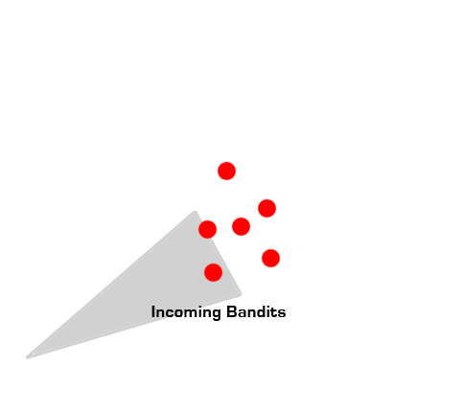
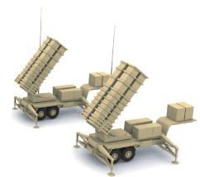
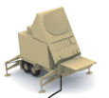
How it Works:
Phase 1 - Engagement Start
Game sends us list of all enemy targets operating in the same nearby area where it initially detected a target.
We build a list of targets to engage, each target is called an ‘engagement channel.’
For each channel, we assign two AA missiles (SAM) to open fire.
So if we are facing 5 targets at once, we launch 10 SAMs to engage them.

Slide 7
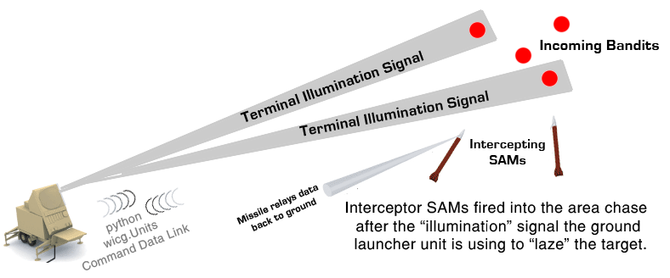
How it Works:
Phase 2 - Terminal Illumination
When 10 fired SAMs arrive at the target area, they have no idea what to target, because they are not traditional Homing Projectiles used in vanilla WIC.
We have to “illuminate” the target for them. This allows them to know which WIC unit to attack as they arrive.
Think of this as “laser designator” in ArmA II, when you have to laze your target for the air player to drop his laser guided bomb onto.
There are only 2 “illumination channels” provided for MW Mod IADS code. This means we can only illuminate/light up 2 air targets at once, and we won’t be able to kill more than 2 targets at a time.

Slide 8
How it Works: “Walking the laser”
Since we only have 2 illuminators available to “laze” our targets, this means we have a big problem when there are more than 2 incoming targets!
As a result, we “walk” our illumination commands using Scheduled Interception strategy.
We delay our SAM launches by 1 second between each launch, so that we have 1 second of time window available to switch our illumination command from one target to another, allowing us to illuminate 6 targets in a time span of 3 seconds, by “walking the laser” two targets at a time.

Slide 9
Benefits and Drawbacks
Pros/Benefits:
  Extremely efficient at dealing with saturation attacks.
  Can engage / shoot down upwards of 5 incoming cruise missiles at once in a single pass.
  Can shoot down upwards of 9 to 12 helicopters at once in a single pass.
Cons/Pitfalls:
  More CPU intensive.
  Race condition problem. Several SAM launchers attempt to engage the same target, only to get told by IADS code to “back off”.
  Race condition issue is solved by using thread locks and semaphores to prevent competing SAM launchers from corrupting the target data and potentially crashing the game.
  The system is monolithic, complicated and can only deal with saturation attacks coming from one direction. If more saturation attacks are coming from another direction, you’re completely sadly out of luck.

Slide 10
Improvements to be made before
MW Mod 2.0 Final Release:
Multi-Threaded Target Acquisition – Search/Track Thread Separation
  We separate out the “search” function that requests list of targets from game into its own python module.
  The search thread continuously runs in the background scanning its sector, even when the SAM launcher is busy engaging list of targets.
  Search function has REENTRANT_ISR() interrupt sub-routine, allowing it to interrupt a running engagement thread to add additional incoming targets to an existing list.
  This allows the SAM to engage more enemy targets as they appear, even when the code is busy working on existing list of targets to kill.

Slide 11
Looking beyond MW Mod 2.0…
The future of WIC’s Integrated Air Defense System after MW Mod 2.0 release..

Slide 12
360-Degrees Engagement Capability and
True Radar Behavior.
Radar functions will be written completely on a separate program module.
Radar Search function will run continuously in the background, scanning its assigned sector boresight.
Once radar search function has acquired a target, it adds the target to data array and continues its search to look for more targets to add.
The data list can be as long as 100 targets with 360 degrees azimuth for the whole team, giving it similar behavior in game as SPY-1 Aegis radar.
This also means, if a radar unit is destroyed, the SAM launchers become INOPERABLE, even if enemy units are visible in your team’s vision!

Slide 13
Inter-Unit Data Link
Search/Tracking Radar Unit sends a “packet” of information containing target air unit along with other mission data information to the main engagement processing code for scheduling an interception.
Missile launcher (TEL) units “register” their presence to the processing code when they spawn, using a python ShooterBase __init__() constructor function.
An IDEM_DATALINK message packet is sent between radar unit, processing unit and the missile launchers/TELs. The IDEM_DATALINK is basically a “Work Order” or “9-LINE” for the SAM site, advising need for engaging enemy target(s).
struct idem_datalink {
float IADS_timestamping;
int PDFCS_IADN_Thread_ID;
int EXG_Message_ID;
double target_magnitude;
double target_heading_planar_xz;
double target_pitch_planar_xy;
int EXG_WICG_UnitID;
}

Slide 14
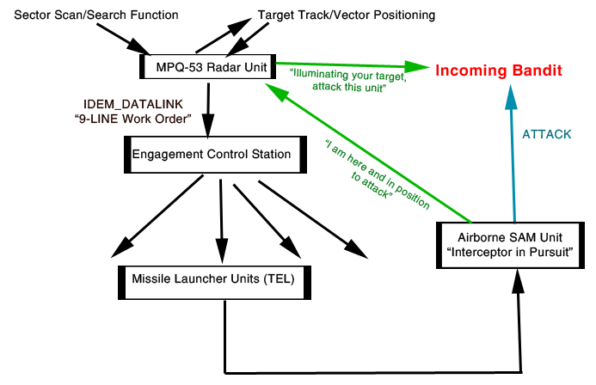
Future SAM Engagement Process
(After 2.0 Release):
The main engagement processing code runs on a separate ground vehicle unit called “Command Post” for S-300, “Engagement Control Station (ECS)” for Patriot.
The flow of data in game looks like this whenever enemy targets are being engaged:

Slide 15
Benefits and Drawbacks
Pros/Benefits:
  No more race conditions.
  Extremely CPU friendly and efficient.
  True simulation of a modern real-life SAM site.
  Physical dependency – if radar unit or ECS unit is destroyed, the entire SAM site becomes inoperable for good, until support player fixes the problem.
  Persistent state handling capability for in-game data stores.
Cons/Drawbacks:
  Talk about over-engineering. Extremely complicated to code.
  Player/human input is completely ignored. Simply turn on the SAM system, and it effectively becomes SkyNet, ignoring every player command and engaging whatever target(s) it wants to.

Slide 16
Open Systems Architecture
By utilizing IDEM_DATALINK messaging structure for all units, we can create an “open systems architecture” model for modern network-centric warfare in World in Conflict, where:
  Enemy units detected by intel-gathering units, such as Patriot radar, AN/APG-78 Longbow Radar can be shared by other units that could engage them.
  For example, Patriot MPQ-53 radar could not only queue up its own Patriot SAM launchers to engage the threat, it could also share and “download” this mission data information to short-range Stinger and medium KM-SAM units, queuing up their firing units in advance for maximum engagement efficiency.
  AN/APG-78 Apache Longbow radar could share its target list with other Apaches using IDEM_DATALINK for unrelenting destruction of ground units, able to target as many targets as your entire team has Hellfire missiles available to fire.
  Early warning radar units could send IDEM_DATALINK message to cruise missile launchers, invoking automated cruise missile launch as soon as enemy unit is detected.

Slide 17
www.wicmwmod.com
We balance the game with more realism.™

